Slide 1

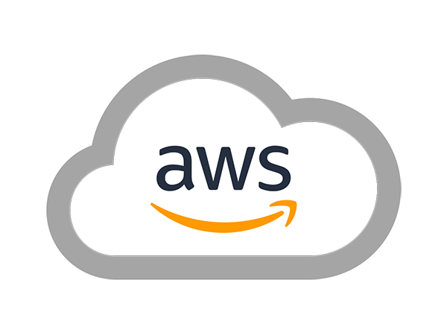
AWS SOLUTIONS ARCHITECT ASSOCIATE
Module 12:
Security on AWS

Slide 2
Module Overview
Shared Responsibility Model
AWS Compliance Program
AWS Global Infrastructure Security
AWS Account Security Features
AWS Cloud Service-Specific Security

Slide 3

Lesson 01: Shared Responsibility Model

Slide 4
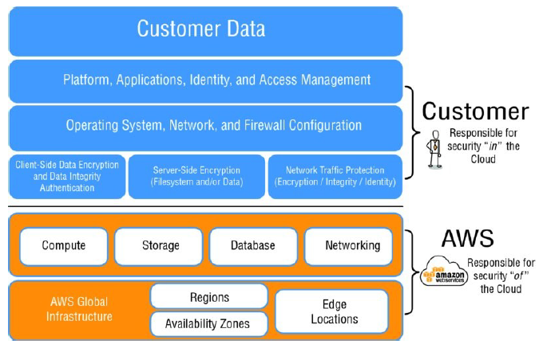
Shared Responsibility Model

Slide 5
Lesson 02: AWS Compliance Program

Slide 6
AWS Compliance Program
Service Organization Control (SOC) 1/Statement on Standards for Attestation
Engagements (SSAE)16/International Standards for Assurance Engagements No. 3402
(ISAE) 3402 (formerly Statement on Auditing Standards [SAS] 70)
SOC 2
SOC 3

Slide 7
AWS Compliance Program
Federal Information Security Management Act (FISMA), Department of Defense (DoD)
Information Assurance Certification and Accreditation Process (DIACAP), and Federal
Risk and Authorization Management Program (FedRAMP)
DoD Cloud Computing Security Requirements Guide (SRG) Levels 2 and 4

Slide 8
AWS Compliance Program
Payment Card Industry Data Security Standard (PCI DSS) Level 1
International Organization for Standardization (ISO) 9001 and ISO 27001
International Traffic in Arms Regulations (ITAR)
Federal Information Processing Standard (FIPS) 140-2

Slide 9
AWS Compliance Program
Criminal Justice Information Services (CJIS)
Cloud Security Alliance (CSA)
Family Educational Rights and Privacy Act (FERPA)
Health Insurance Portability and Accountability Act (HIPAA)
Motion Picture Association of America (MPAA)

Slide 10
Lesson 03: AWS Global Infrastructure Security

Slide 11
AWS Global Infrastructure Security
Physical and Environmental Security
  Fire Detection and Suppression
  Power
  Climate and Temperature
  Management
  Storage Device Decommissioning

Slide 12
AWS Global Infrastructure Security
Business Continuity Management
  Availability
  Incident Response
  Communication
Network Security
  Secure Network Architecture
  Secure Access Points
  Transmission Protection

Slide 13
AWS Global Infrastructure Security
Network Monitoring and Protection
  Distributed Denial of Service (DDoS)
  Man in the Middle (MITM)
  IP Spoofing
  Port Scanning
  Packet Sniffing by Other Tenants

Slide 14
Lesson 04: AWS Account Security Features

Slide 15
AWS Account Security Features
AWS Credentials
Passwords
AWS Multi-Factor Authentication (AWS MFA)
Access Keys
Key pairs
AWS CloudTrail

Slide 16
Lesson 05: AWS Cloud Service-Specific Security

Slide 17
AWS Cloud Service-Specific Security
Compute Services
  Amazon Elastic Compute Cloud (Amazon EC2) Security
Networking
  Elastic Load Balancing Security
  Amazon Virtual Private Cloud (Amazon VPC) Security
  Amazon CloudFront Security

Slide 18
AWS Cloud Service-Specific Security
Storage
  Amazon Simple Storage Service (Amazon S3) Security
  Data Access
  Data Transfer
  Data Storage
  Access Logs
  Cross-Origin Resource Sharing (CORS)

Slide 19
AWS Cloud Service-Specific Security
Amazon Glacier Security
  Data Transfer
  Data Retrieval
  Data Storage
  Data Access

Slide 20
AWS Cloud Service-Specific Security
AWS Storage Gateway Security
  Data Transfer
  Data Storage
Database
  Amazon DynamoDB Security
  Amazon Relational Database Service (Amazon RDS) Security
  Amazon Redshift Security
  Amazon ElastiCache Security

Slide 21
AWS Cloud Service-Specific Security
Application Services
  Amazon Simple Queue Service (Amazon SQS) Security
  Amazon Simple Notification Service (Amazon SNS) Security
  Analytics Services
  Amazon Elastic MapReduce (Amazon EMR) Security
  Amazon Kinesis Security

Slide 22
AWS Cloud Service-Specific Security
Deployment and Management Services
  AWS Identity and Access Management (IAM) Security
  Mobile Services
  Amazon Cognito Security
Applications
  Amazon WorkSpaces Security

Slide 23
Lab Module 7

